Slide 1
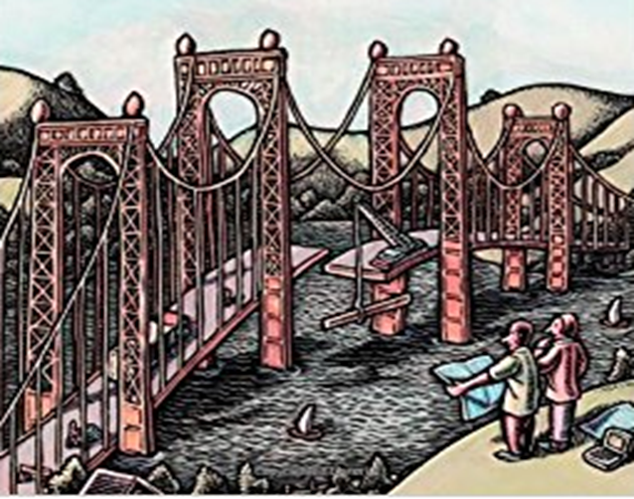
Behavioral Models
(Activity Model)

Slide 2
Activity Model
We have looked at the structural models which describe the solution structure in terms of classes/objects their characteristics, their relationships.
We discussed their representation as a set of component diagrams as part of breaking up the system into implementable smaller manageable submodules.
We also discussed the deployment diagram which associated these components to physical hosts/devices where these components would be executed.
In the set of following sessions we will discuss on bringing in the interactions between these classes/objects and components into a set of dynamic or behavioral models.
There are two basic models which we will discuss, for bringing in the dynamic behavior or interactions of the classes to produce useful results.
Activity Models
Sequence Models

Slide 3
Activity Diagrams
It’s a flow chart showing flow of control from activity to activity with the focus on operations rather than on objects
It involves modelling and showing the sequential (and possibly concurrent) steps in the computational process (which could be a like a algorithm or workflow) thus factoring in essential dependencies between activities as part of operation
Actions which are being represented in the Activity diagram, encompass calling another operation, sending a signal, creating or destroying an object or some pure computation such as evaluating an expression
Activity diagram summarily represents some action which is made up of executable atomic computations that results in change in the state of the system, or the return of a value
Overall it represents the workflow of the process
Can be used at any level of abstraction
Algorithm
Business Process

Slide 4
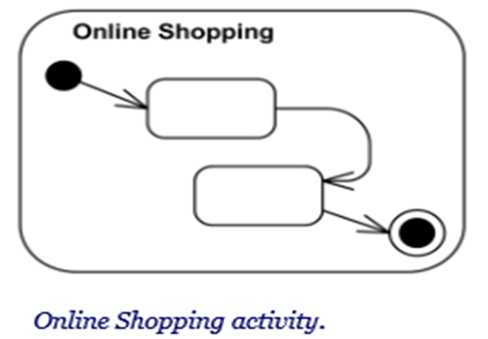
Constituents or Notions of an Activity Diagrams
Activity
Activity is a parameterized behavior represented as coordinated flow of actions.
Action
Action is a named element which represents a single atomic step within activity, i.e. that is not further decomposed within the activity or Activity represents a behavior that is composed of individual elements that are actions.
Activities may contain actions of various kinds:
Occurrences of primitive functions, such as arithmetic functions.
Invocations of behavior
Communication actions, such as sending of signals.
Manipulations of objects, such as reading or writing attributes or associations.
There are actions that invoke other activities - either directly using call behavior or indirectly with call operation action

Slide 5
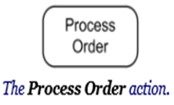
Constituents or Notions of an Activity Diagrams
Action (Cont.)
An action is indicated on the activity diagram by a "capsule" shape – a rectangular object with semi circular left and right ends.
Name of the action is usually action verb or noun for the action with some explanation E.g. Fill Order, Review Document, Receive Order etc.
An action will not begin execution until all of its input conditions are satisfied. The completion of the execution of an action may enable the execution of a set of successor nodes and actions that take their inputs from the outputs of the action

Slide 6
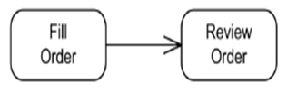

Constituents or Notions of an Activity Diagrams
Transition (Activity Edge or Transition Line)
Transition is represented by a directed line and could be named or not
When the action or an activity state completes, flow of control passes immediately to the next action or activity state E.g.
Activity Edge is an abstract class for the directed connections along which tokens or data objects flow between activity nodes. It includes control edges and object flow edges. The source and target of an edge must be in the same activity as the edge
Activity edge can have a guard - specification evaluated at runtime to determine if the edge can be traversed. The guard must evaluate to true for every token that is offered to pass along the edge [Eg. Evaluation of priority to a value = 1]
Action Action

Slide 7
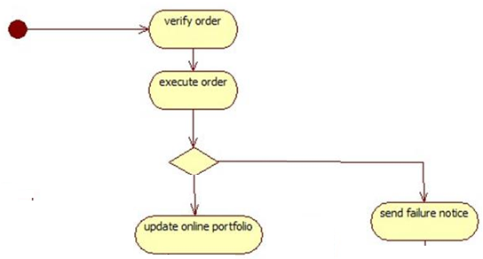
Constituents or Notions of an Activity Diagrams
Branches
If there is more than one successor to an action, each arrow (activity edge) may be labelled with a condition in square bracket.
It specifies alternate paths taken based on some Boolean expression
This branch is represented as a diamond. This could have one incoming path and more than one outgoing paths
[Condition]
[Else]
[Condition]
[failure to Execute]
[Order Successful]

Slide 8

Constituents or Notions of an Activity Diagrams
Initiation and Termination
A solid circle with an outgoing arrow shows the starting point for the action sequence within an activity diagram. It starts with the solid circle (Start Marker also known as initial state) and proceeds via the outgoing arrow towards the first activities
There can be only one initial state on an activity diagram and only one transition line connecting the initial state to an action.
A bulls-eye (a solid circle surrounded by a hollow circle shows the termination point. At this stage overall activity is complete (Stop Marker)

Slide 9
Constituents or Notions of an Activity Diagrams
Concurrency
Systems and Organizations can perform more than one actions at a time. These actions can happen at different speeds. These are represented using the fork and solid line to synchronize the beginning. After all the actions are completed, this is marked of completion of the activity using Merge
Fork
The activities of each of outgoing transitions are concurrent
Order of initiation is not specified or guaranteed
Merge/Join
Actions may end in different order
Variants
Splitting Bar (Fork)
Synch. Bar (Join/Merge)
Fork
{AND}
{OR}
{XOR}
Join (Merge)

Slide 10
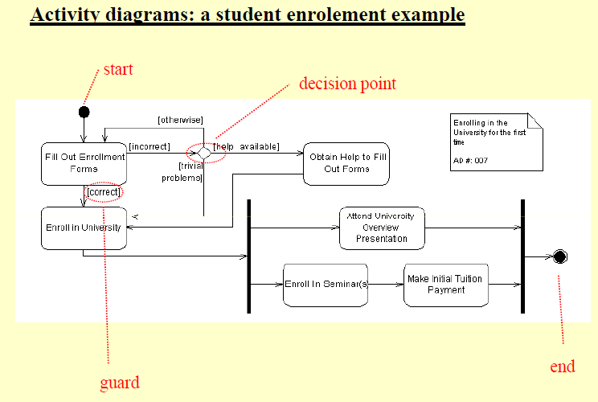
Activity Diagrams
branch or decision point
merge/join
action
Activity edge or transition
fork

Slide 11
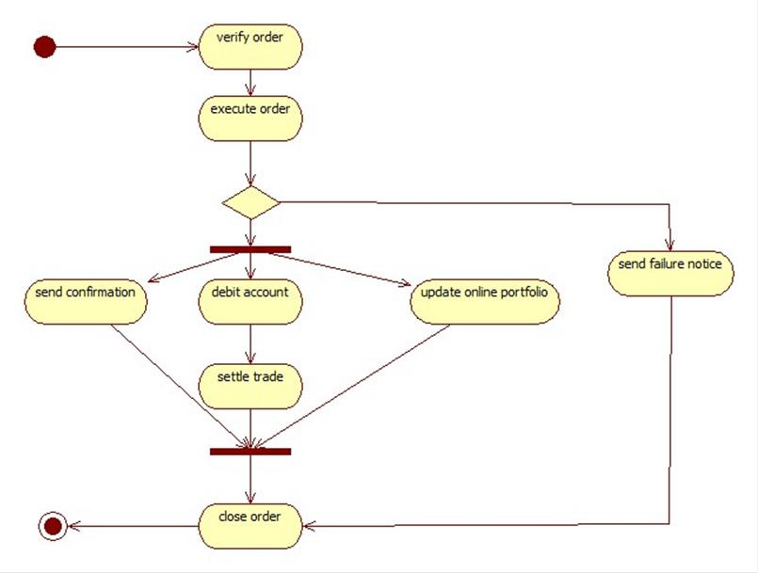
Activity diagram (Stock Trade Processing)

Slide 12
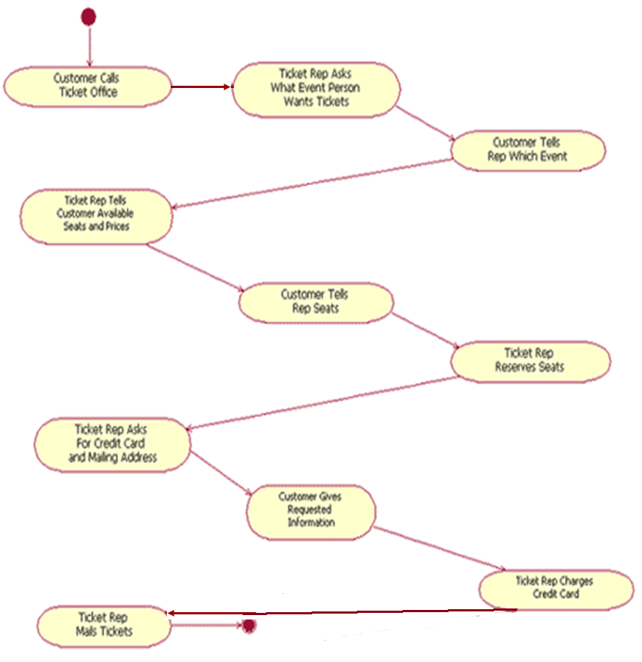
Activity Diagrams

Slide 13
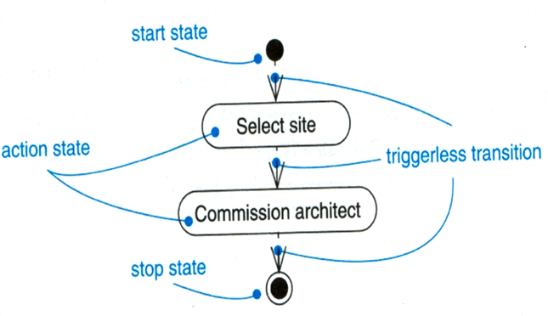
Activity diagram
Activity states and action states
Action states are atomic and cannot be decomposed
Activity states can be further decomposed
Their activity being represented by other activity diagrams
They may be interrupted
Transitions
When the action or activity of a state completes, flow of control passes immediately to the next action or activity state

Slide 14
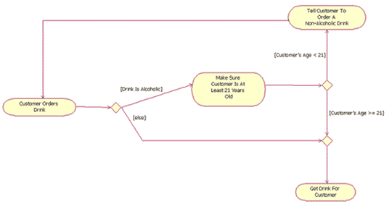
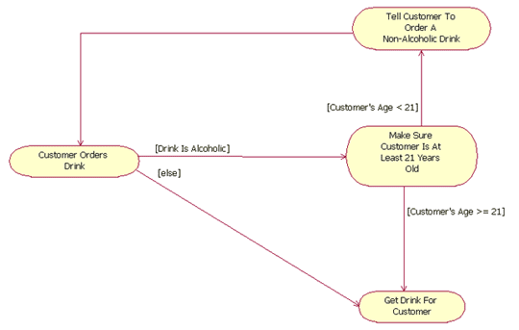
Partial Activity diagram`
A partial activity diagram, showing two decision points ("Drink is alcoholic" and "Customer's age < 21") and one merge ("else" and "Customer's age >= 21")
with Merge Points without Merge

Slide 15
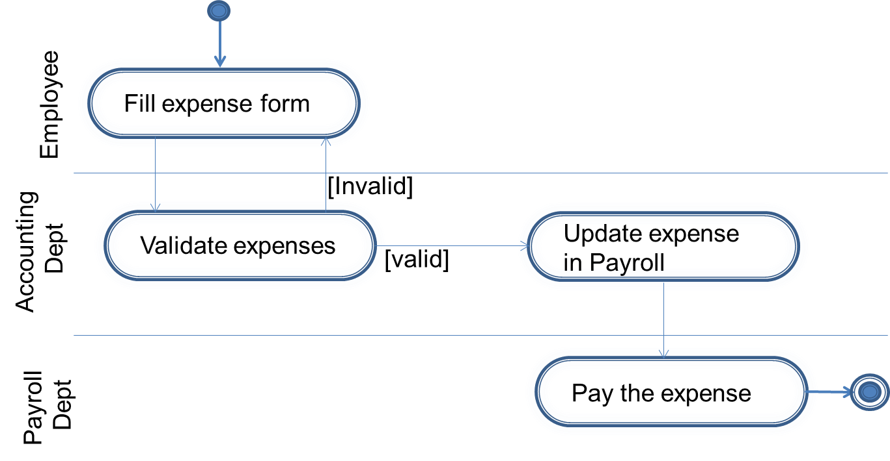
Swim Lanes
Swimlane or an activity partition is a high-level grouping of a set of related actions with straight line boundaries as placing responsibilities with competitors at a swim meet.
This helps in partitioning actions on an activity diagrams into groups where each group could represent an Business Organization responsible for the activities
In UML each of the partitions (typically are the activities of a single actor or a group of activities happening in a single thread) or swimlanes are visually depicted as a solid horizontal line (or a vertical line)
Swimlane
Swimlane
Swimlane

Slide 16
Swim Lanes
SwimLanes : (Cont.)
Help understand “division” of work and activity flow across involved parties
Interface points (swimlane boundaries) are clarified

Slide 17
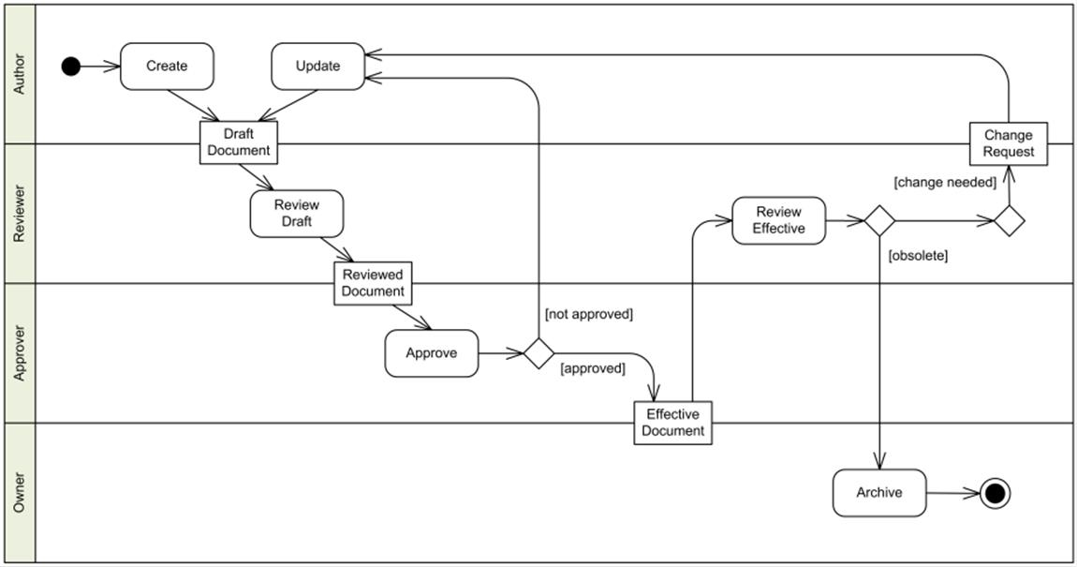
Swim Lanes/Object Flow
Object flow refers to the creation and modification of objects by activities
An object flow arrow from an action to an object means that the action creates or influences the object.
An object flow arrow from an object to an action indicates that the action state uses the object.
In activities it would be important to have the input and output of activity
Key objects can be showed as part of the activity flow
Object
Creation
Uses

Slide 18
Guidelines for Activity Diagram
Don’t misuse activity diagram :- Elaborate use case & sequence model to study algorithm & workflow.
Level diagram :- Activities on a diagram should be consistent level of detail. place additional details for activity in separate diagram.
Be careful with branches & conditions:- At least one condition should be satisfied.
Be careful with concurrent activities :- Before a merge can happen all inputs must first complete.

